Slide 1










AI Master Class Series –
Day – 7/30
தமிழ்
Face Recognition using OpenCV

Slide 2
Face recognition.
01

Slide 3
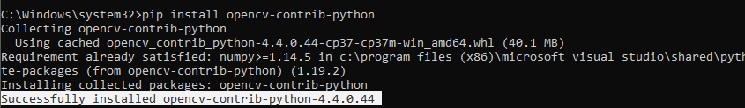
Installing Libraries
Opencv-contrib: pip install opencv-contrib-python

Slide 4
Face recognition.
Face recognition is a method of identifying or verifying the identity of an individual using their face. Face recognition systems can be used to identify people in photos, video, or in real-time.
Preventing crime
Unlock device
Blind assistance
Attendance system
Payments

Slide 5
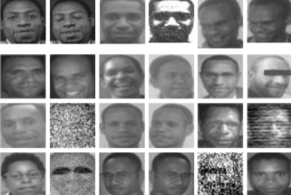
Fisher face Recognizer
Fisherfaces algorithm extracts principle components that separates one individual from another. So , now an individual's features can't dominate another person's features.
Fisherface method will be applied to generate feature vector of facial image data used by system and then to match vector of traits of training image with vector characteristic of test image using euclidean distance formula

Slide 6
LBPH Face Recognizer
Local Binary Pattern (LBP) is a simple yet very efficient texture operator which labels the pixels of an image by thresholding the neighborhood of each pixel and considers the result as a binary number.
It doesn't look at image as a whole, but instead tries to find its local structure by comparing each pixel to its neighboring pixels.
LBPH uses 4 parameters
Radius - to build the circular local binary pattern and represents the radius around the central pixel. It is usually set to 1.
Neighbors - : The more sample points you include, the higher the computational cost. It is usually set to 8
X Grid - the number of cells in the horizontal direction.
Y Grid - the number of cells in the vertical direction.

Slide 7
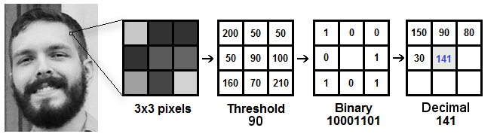
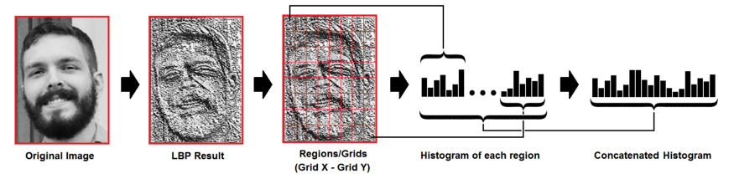
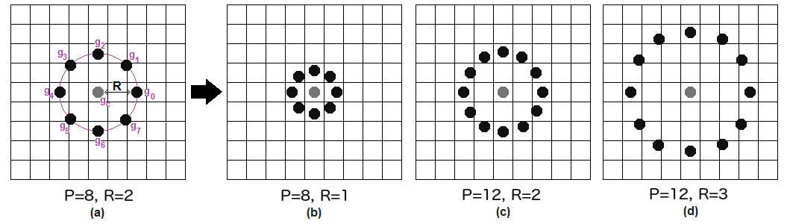
Circular LBP

Slide 8
Block Diagram–Workflow of Face Recognition
Loading face detection algorithm
Loading Classifier for face recognition
Training classifier for our dataset
Reading frame from camera & pre-processing
Face detection by its algorithm
Predicting face by loading frame into model
Displays recognized class with its accuracy

Slide 9
Creating dataset
02
Hands-on

Slide 10
Face recognition
03

Slide 11
🧠Mindset Task of the Day💡
Practical Task – Write down you list of
Bad Habits and tear the paper and burn it !

Slide 12

Thanks
Do you have
Course related questions?
+91 9363083283
Pantechsolutions.net
Follow Me on the LinkedIn – Link in Description

